Slide 1
Understanding NoSQL Databases
NoSQL Database
CS3EL17
Instructor: Dr. Latika Jindal

Slide 2
Unit 1- Introduction To NoSQL
Understanding NoSQL Databases, History of NoSQL, Features of NoSQL, Scalability, Cost, Flexibility
NoSQL Business Drivers, Classification and Comparison of NoSQL Databases.
Consistency– Availability - Partitioning (CAP), Limitations of Relational Databases, Comparing NoSQL with RDBMS
Managing Different Data Types, Columnar, Key-Value Stores, Triple and Graph Stores
Document, Search Engines
Hybrid NoSQL Databases,Applying Consistency Methods
ACID, BASE,Polyglot persistence

Slide 3
Learning Objectives
Understand the fundamental concept of NoSQL databases and how they differ from relational databases.
Trace the historical evolution of NoSQL technologies and the conditions that led to their emergence.
Identify the core features that distinguish NoSQL databases from traditional RDBMS.
Analyze how NoSQL databases achieve horizontal scalability across distributed systems.
Evaluate the cost implications of adopting NoSQL solutions compared to relational alternatives.
Apply an understanding of schema flexibility to determine when NoSQL is the appropriate choice for an application.

Slide 4
What is a NoSQL Database?
NoSQL stands for 'Not Only SQL', referring to a broad class of database systems that do not rely exclusively on the traditional relational model.
These databases are designed to store, manage, and retrieve data that does not fit neatly into fixed rows and columns.
NoSQL systems are commonly categorized into four types: document, key-value, column-family, and graph databases.
Unlike relational databases, NoSQL systems typically favor availability and partition tolerance over strict consistency, following the principles of the CAP theorem.
Popular examples include MongoDB, Cassandra, Redis, and Neo4j, each optimized for different data patterns.

Slide 5
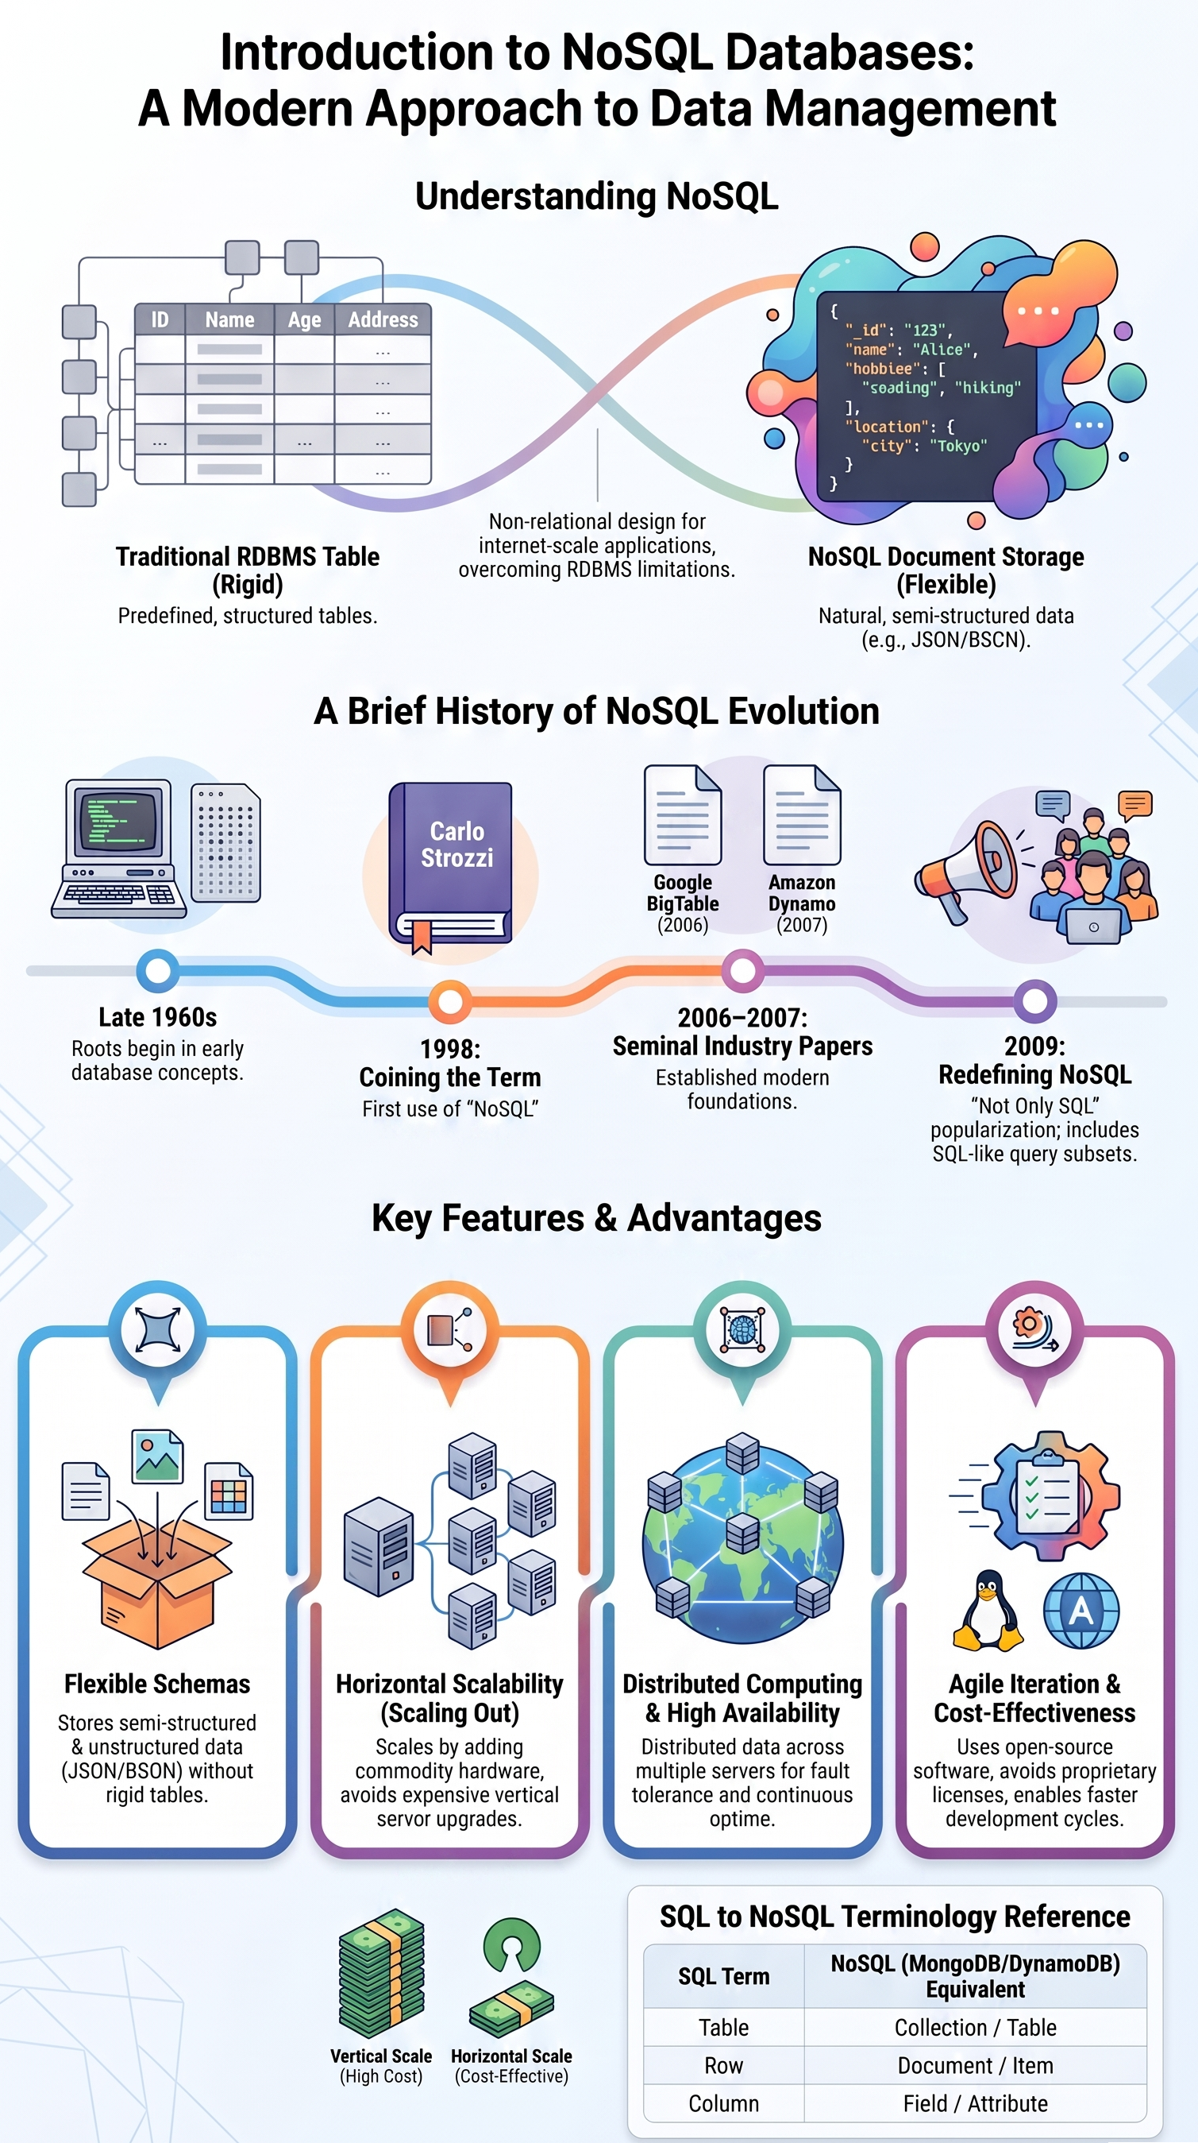

Slide 6
History of NoSQL
The relational model dominated database design from the 1970s through the early 2000s, built around ACID transactions and normalized schemas.
The rapid growth of web-scale applications like Google, Amazon, and Facebook in the mid-2000s exposed the limitations of relational systems under massive concurrent load.
Google's Bigtable (2006) and Amazon's Dynamo (2007) papers introduced distributed, non-relational storage architectures that directly inspired later NoSQL systems.
The term 'NoSQL' was popularized in 2009 during a meetup organized to discuss open-source, non-relational, distributed databases.
Since then, NoSQL has grown into a mature ecosystem supporting big data, real-time analytics, and cloud-native applications.

Slide 7
Core Features of NoSQL Databases
Schema-less or dynamic schema design allows data structures to evolve without costly migrations.
Horizontal scalability enables systems to grow by adding commodity servers rather than upgrading a single machine.
Distributed architecture with built-in replication provides fault tolerance and high availability.
Eventual consistency models allow NoSQL systems to remain highly available even during network partitions.
Optimized query languages and APIs are tailored to specific data models, such as document queries or graph traversals.

Slide 8
NoSQL Data Models and Types
Key-value stores, such as Redis and DynamoDB, map unique keys to values and are optimized for extremely fast lookups.
Document databases, such as MongoDB and Couchbase, store semi-structured data as JSON-like documents that can nest complex objects.
Column-family stores, such as Cassandra and HBase, organize data into columns grouped by families, suited for write-heavy analytical workloads.
Graph databases, such as Neo4j and Amazon Neptune, represent data as nodes and edges to efficiently model highly connected relationships.
Choosing the right model depends on access patterns, query complexity, and the shape of the underlying data.

Slide 9
Real-World Example: Scalability in Practice
Netflix uses Cassandra to handle billions of writes per day across a globally distributed subscriber base without a single point of failure.
Cassandra's peer-to-peer architecture allows Netflix to add nodes seamlessly during traffic spikes, such as new content releases.
Sharding and data partitioning distribute load evenly across servers, preventing any single node from becoming a bottleneck.
Auto-scaling in cloud-hosted NoSQL services, such as DynamoDB, dynamically adjusts capacity based on real-time demand.
This elastic scalability model contrasts sharply with the vertical scaling limits typical of traditional relational databases.

Slide 10
Real-World Example: Cost Efficiency and Flexibility in Industry
Airbnb adopted MongoDB to manage rapidly evolving listing and booking data without redesigning schemas for every new feature.
Commodity hardware and open-source licensing reduce infrastructure costs compared to proprietary relational database licenses.
Pay-as-you-go cloud NoSQL offerings, such as DynamoDB and Firestore, let startups avoid large upfront capital investment.
Flexible schemas reduce developer time spent on migrations, accelerating feature delivery in agile development cycles.
However, cost savings must be weighed against the operational expertise required to manage distributed NoSQL clusters effectively.

Slide 11
Advanced Topics and Current Challenges
Ensuring strong consistency in distributed NoSQL systems remains an active area of research, balancing the trade-offs described by the CAP theorem.
Multi-model databases, such as ArangoDB and CosmosDB, are emerging to combine document, graph, and key-value capabilities in a single engine.
NewSQL systems attempt to merge relational guarantees with NoSQL-style horizontal scalability, blurring traditional category lines.
Data governance, security, and compliance are more complex in schema-less environments where data structures vary across records.
Ongoing research explores machine learning-driven query optimization and automated indexing for large-scale NoSQL deployments.

Slide 12
Summary
NoSQL databases emerged to address the scalability and flexibility limitations of traditional relational systems.
They are broadly classified into key-value, document, column-family, and graph models, each suited to different use cases.
Horizontal scalability allows NoSQL systems to grow elastically across distributed commodity hardware.
Cost efficiency stems from open-source licensing and pay-as-you-go cloud models, though operational overhead must be considered.
Schema flexibility accelerates development but introduces new challenges around consistency and data governance.
The choice between SQL and NoSQL should be driven by application requirements rather than technology trends alone.

Slide 13
Discussion Questions
In what scenarios would the eventual consistency model of a NoSQL database be unacceptable for a business application?
How do the four major NoSQL data models differ in their approach to representing relationships between data entities?
Given the cost and flexibility advantages of NoSQL, why do many enterprises still rely heavily on relational databases for core operations?

Slide 14
References
Sadalage, P. J., & Fowler, M. (2013). NoSQL Distilled: A Brief Guide to the Emerging World of Polyglot Persistence. Addison-Wesley.
Chang, F., Dean, J., Ghemawat, S., et al. (2008). Bigtable: A Distributed Storage System for Structured Data. ACM Transactions on Computer Systems, 26(2), 1-26.
DeCandia, G., Hastorun, D., Jampani, M., et al. (2007). Dynamo: Amazon's Highly Available Key-value Store. Proceedings of the 21st ACM SIGOPS Symposium on Operating Systems Principles.
Cattell, R. (2011). Scalable SQL and NoSQL Data Stores. ACM SIGMOD Record, 39(4), 12-27.
MongoDB, Inc. (2024). MongoDB Documentation: Introduction to MongoDB. https://www.mongodb.com/docs/manual/introduction/

Slide 15
THANK YOU
We hope this lecture was insightful and engaging.

Slide 16
NoSQL Business Drivers, Classification and Comparison of NoSQL Databases
NoSQL Database
CS3EL17
Instructor: Dr. Latika Jindal

Slide 17
Learning Objectives
Understand the business drivers that motivated organizations to adopt NoSQL database technologies.
Identify the volume, velocity, and variety challenges that traditional relational databases struggle to address.
Classify NoSQL databases into their four major categories based on data model and structure.
Compare key-value, document, column-family, and graph databases in terms of strengths and trade-offs.
Analyze how business requirements such as agility, scale, and cost drive the choice of a specific NoSQL category.
Evaluate real-world case studies to determine which NoSQL classification best fits a given business scenario.

Slide 18
Why Businesses Moved to NoSQL
The explosive growth of web, mobile, and social platforms in the 2000s created data volumes and user loads far beyond what single-server relational systems could handle.
Businesses needed systems that could scale horizontally across many low-cost servers rather than relying on expensive vertical scaling.
Rapidly changing application requirements demanded flexible, schema-less data models that could evolve without downtime.
Global user bases required low-latency access and high availability across geographically distributed data centers.
Rising volumes of semi-structured and unstructured data, such as logs, sensor feeds, and user-generated content, did not map well to rigid relational tables.

Slide 19
Core Business Drivers of NoSQL Adoption
Volume: the need to store and process petabytes of data generated by modern applications and IoT devices.
Velocity: the requirement to ingest and query data in real time, such as fraud detection or recommendation engines.
Variety: the diversity of data formats, including JSON documents, time-series data, and graph-structured relationships.
Agility: shorter development cycles demand databases that support rapid iteration without formal schema migrations.
Cost pressure: open-source licensing and commodity hardware reduce total cost of ownership compared to proprietary relational systems.

Slide 20
Classifying NoSQL Databases
Key-value stores organize data as simple pairs of unique keys and associated values, offering the fastest possible lookups.
Document databases store self-describing, semi-structured records, typically in JSON or BSON format, allowing nested and variable fields.
Column-family stores group related data into column families rather than rows, optimizing for large-scale write and analytical workloads.
Graph databases model data as nodes and edges, making them ideal for representing and traversing complex relationships.
Each category trades off consistency, query flexibility, and performance differently, so classification guides database selection.

Slide 21
Comparing NoSQL Categories
Key-value stores, such as Redis and DynamoDB, excel at caching and session management but offer limited query capability beyond the key.
Document databases, such as MongoDB, support rich queries and indexing on nested fields, making them versatile for general-purpose applications.
Column-family stores, such as Cassandra and HBase, handle massive write throughput and time-series data efficiently but require careful data modeling.
Graph databases, such as Neo4j, outperform relational joins for deeply connected data but are not designed for high-volume transactional workloads.
No single NoSQL category is universally superior; the right choice depends on access patterns, consistency needs, and expected scale.

Slide 22
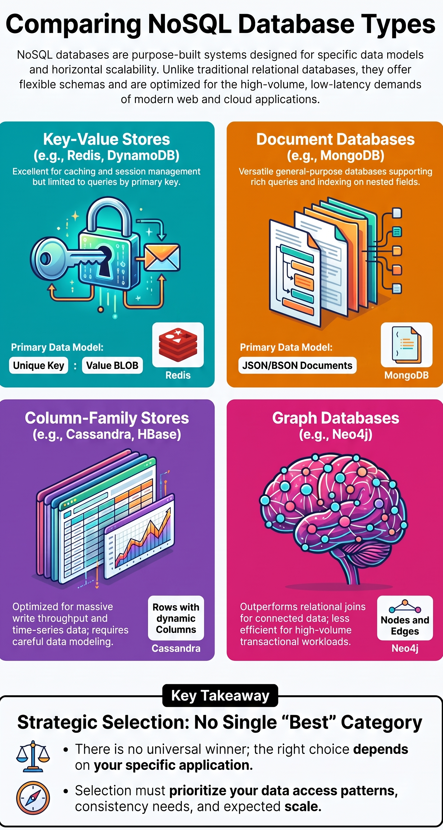

Slide 23
Real-World Example: Business-Driven NoSQL Selection at Uber
Uber uses a combination of NoSQL technologies, including a custom key-value store, to handle real-time trip and location data at massive scale.
Low-latency key-value lookups are critical for matching riders and drivers within milliseconds across global cities.
Uber's engineering teams selected specific NoSQL categories based on distinct business needs, such as geospatial indexing versus transactional consistency.
This polyglot persistence strategy, using multiple NoSQL types together, reflects how business requirements shape technology classification choices.
The approach illustrates that classification is not just academic but directly tied to measurable business outcomes like reduced matching time.

Slide 24
Real-World Example: Comparing NoSQL Choices at LinkedIn
LinkedIn developed and adopted Voldemort, a key-value store, for its social graph and recommendation features requiring fast, simple lookups.
For messaging and content feeds, document-oriented approaches offered the flexibility to evolve data structures as features expanded.
LinkedIn's engineering blog highlights how column-family stores were evaluated for analytics workloads processing billions of events daily.
Comparative benchmarking of latency, throughput, and consistency guarantees informed which NoSQL category was deployed for each service.
This case demonstrates how enterprises compare NoSQL classifications empirically rather than choosing based on popularity alone.

Slide 25
Advanced Considerations in NoSQL Classification
Multi-model databases, such as ArangoDB and Azure Cosmos DB, blur classification boundaries by supporting several data models within one engine.
Choosing between categories increasingly involves evaluating consistency models, such as strong versus eventual consistency, alongside data structure.
Benchmarking frameworks like YCSB (Yahoo Cloud Serving Benchmark) provide standardized ways to compare performance across NoSQL categories.
Emerging research explores automated database selection tools that recommend a NoSQL category based on workload characteristics.
As data ecosystems grow more complex, organizations increasingly adopt polyglot persistence, combining multiple NoSQL types to match diverse business needs.

Slide 26
Summary
Business drivers such as volume, velocity, variety, agility, and cost pressure pushed organizations away from purely relational systems.
NoSQL databases are classified into four primary categories: key-value, document, column-family, and graph.
Each category offers distinct strengths, making comparison essential before selecting a database for a given workload.
Real-world companies like Uber and LinkedIn often adopt multiple NoSQL categories simultaneously, a strategy known as polyglot persistence.
Classification is not purely academic; it directly maps to measurable business outcomes like latency, scalability, and cost.
Choosing the right NoSQL category requires evaluating access patterns, consistency requirements, and expected data growth.

Slide 27
Discussion Questions
Which business drivers would most strongly justify a company migrating from a relational database to a NoSQL solution?
How would you decide between a document database and a column-family store for an application with rapidly growing user-generated content?
What risks might an organization face by adopting a polyglot persistence strategy using multiple NoSQL categories at once?

Slide 28
References
Sadalage, P. J., & Fowler, M. (2013). NoSQL Distilled: A Brief Guide to the Emerging World of Polyglot Persistence. Addison-Wesley.
Cattell, R. (2011). Scalable SQL and NoSQL Data Stores. ACM SIGMOD Record, 39(4), 12-27.
Cooper, B. F., Silberstein, A., Tam, E., Ramakrishnan, R., & Sears, R. (2010). Benchmarking Cloud Serving Systems with YCSB. Proceedings of the 1st ACM Symposium on Cloud Computing, 143-154.
Moniruzzaman, A. B. M., & Hossain, S. A. (2013). NoSQL Database: New Era of Databases for Big Data Analytics - Classification, Characteristics and Comparison. International Journal of Database Theory and Application, 6(4), 1-14.
DataStax, Inc. (2024). What is NoSQL? Cassandra Documentation. https://www.datastax.com/nosql

Slide 29
THANK YOU
We hope this lecture was insightful and engaging.

Slide 30
Consistency, Availability, Partitioning (CAP), Limitations of Relational Databases, and Comparing NoSQL with RDBMS
NoSQL Database
CS3EL17
Instructor: Dr. Latika Jindal

Slide 31
Learning Objectives
Understand the three properties of the CAP theorem: Consistency, Availability, and Partition Tolerance.
Explain why a distributed system can guarantee at most two of the three CAP properties simultaneously.
Identify the structural and operational limitations of traditional relational database systems.
Analyze how NoSQL databases address the scalability and flexibility gaps left by relational systems.
Compare NoSQL and RDBMS across dimensions such as schema design, consistency, and scalability.
Evaluate which database paradigm, relational or NoSQL, best fits a given application scenario.

Slide 32
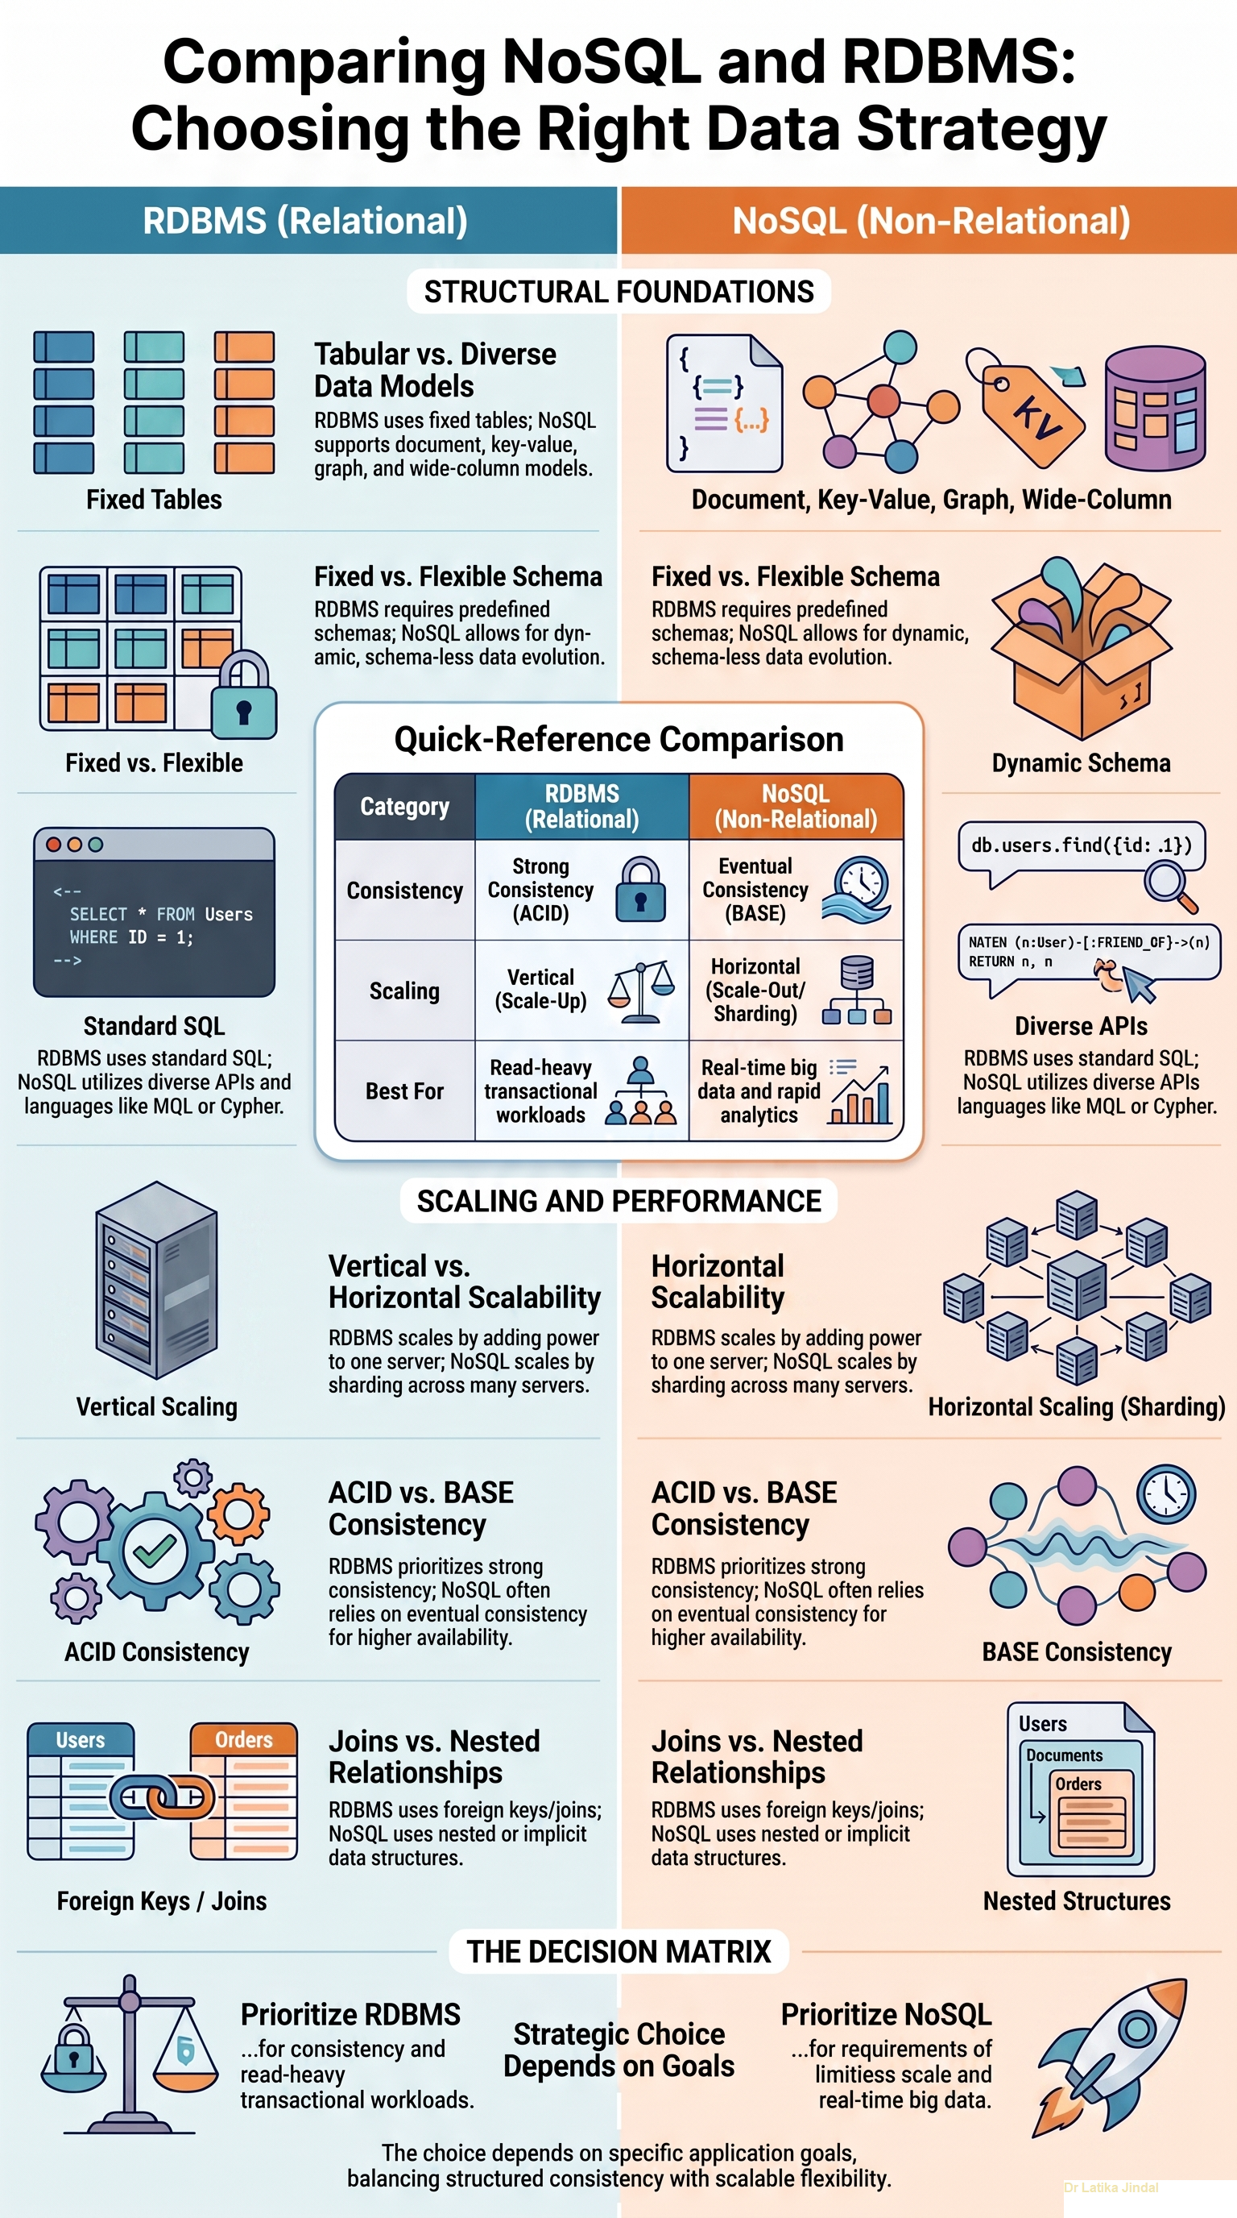

Slide 33
Introducing the CAP Theorem
The CAP theorem, formulated by Eric Brewer in 2000, states that a distributed data store can provide at most two of three guarantees: Consistency, Availability, and Partition Tolerance.
Consistency means every read receives the most recent write or an error, so all nodes see the same data at the same time.
Availability means every request receives a non-error response, without guaranteeing that it contains the most recent write.
Partition Tolerance means the system continues to operate despite network failures that prevent some nodes from communicating with others.
Because network partitions are unavoidable in real distributed systems, designers must effectively choose between prioritizing consistency or availability during a partition.

Slide 34
CAP Trade-offs in Practice
CP systems, such as HBase and MongoDB in certain configurations, sacrifice availability to guarantee strong consistency during a network partition.
AP systems, such as Cassandra and DynamoDB, sacrifice strict consistency to remain available, later reconciling data through eventual consistency.
CA systems, which guarantee consistency and availability, are only truly achievable in non-partitioned environments, such as a single-node database.
Eventual consistency allows replicas to temporarily diverge but guarantees they will converge to the same value once updates propagate.
Understanding CAP trade-offs helps architects select a database configuration aligned with an application's tolerance for stale data versus downtime.

Slide 35
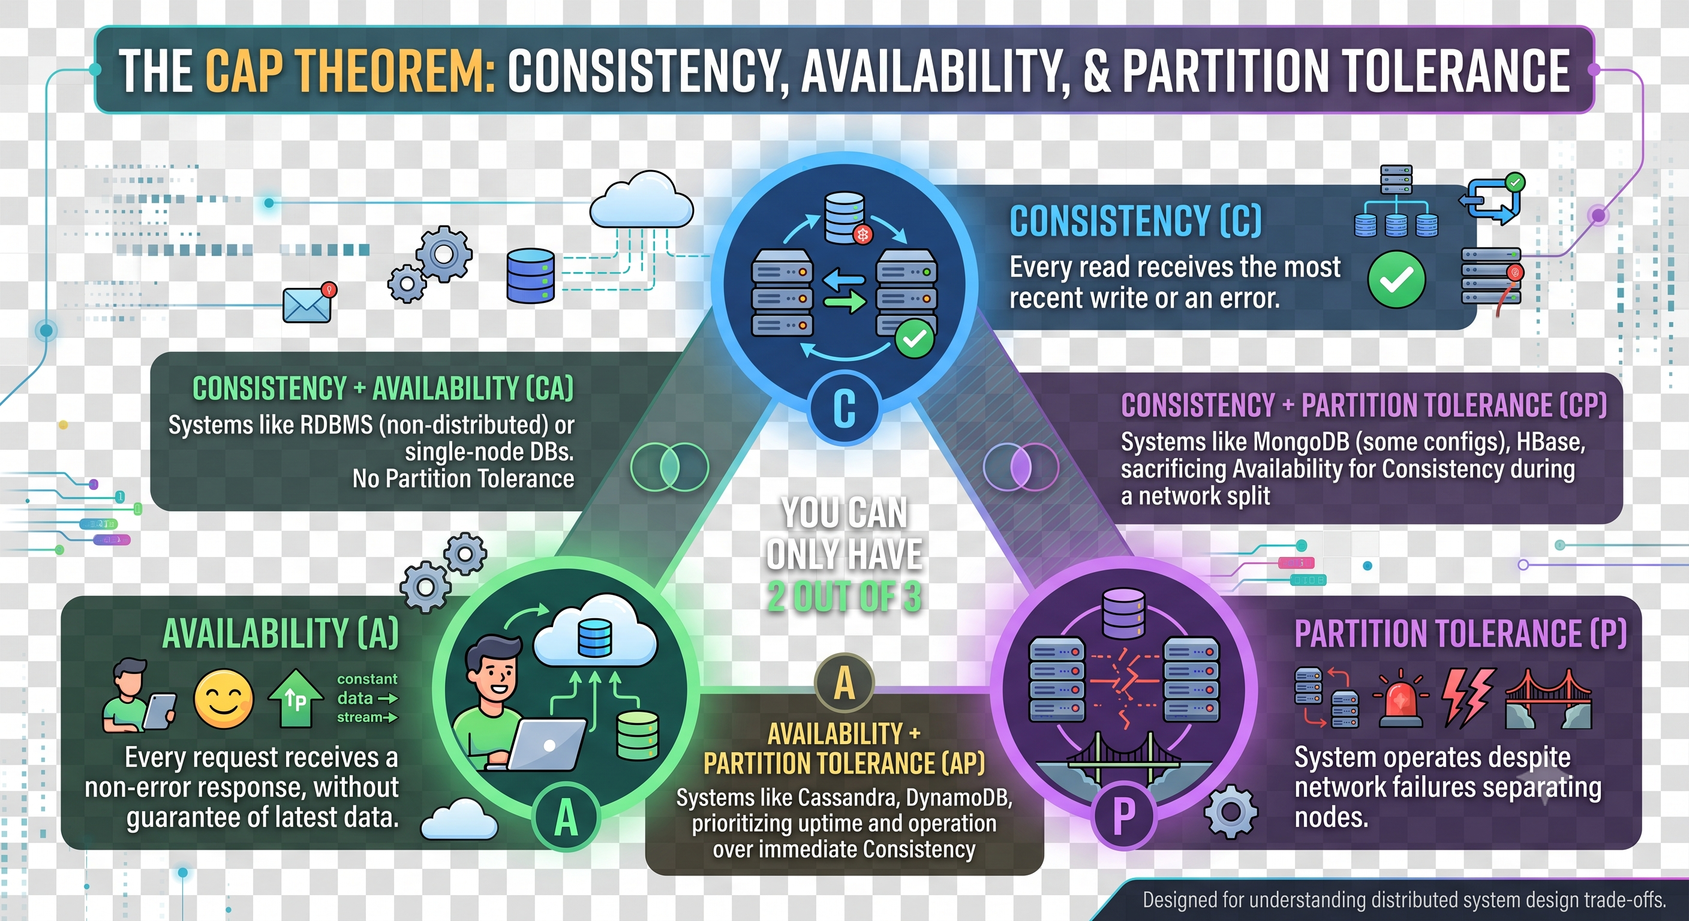

Slide 36
Limitations of Relational Databases
Rigid, predefined schemas make relational databases costly and slow to modify as application requirements evolve.
Vertical scaling, adding more power to a single server, has physical and financial limits that cap how much a relational system can grow.
Complex JOIN operations across large, normalized tables can degrade performance significantly as data volume increases.
Relational databases were not originally designed to handle unstructured or semi-structured data, such as JSON documents or graph relationships.
Strict ACID compliance, while ensuring reliability, can introduce latency and reduce throughput in massively distributed, high-velocity environments.

Slide 37
How NoSQL Addresses These Limitations
Dynamic or schema-less designs let NoSQL databases store varied data structures without requiring upfront schema definition.
Horizontal scaling across commodity servers allows NoSQL systems to grow capacity by adding nodes rather than upgrading hardware.
Denormalized data models reduce the need for expensive JOIN operations, improving read performance for large datasets.
Native support for semi-structured formats, such as JSON documents, aligns naturally with modern application development.
Relaxed consistency models, guided by the CAP theorem, allow NoSQL systems to prioritize availability and partition tolerance where appropriate.

Slide 38
Real-World Example: CAP Trade-offs at Amazon DynamoDB
Amazon designed DynamoDB as an AP system, prioritizing availability so that shopping cart operations never fail even during network issues.
During a network partition, DynamoDB allows writes to proceed on multiple replicas, later resolving conflicts through versioning and reconciliation.
This design choice reflects Amazon's business priority: a customer being able to add an item to their cart matters more than instant consistency.
DynamoDB later introduced optional strongly consistent reads for use cases where stale data would be unacceptable, showing CAP is a spectrum, not a binary choice.
This case illustrates how CAP theorem principles directly translate into concrete architectural and business decisions.

Slide 39
Real-World Example: RDBMS Limitations at Twitter's Early Scale
Twitter initially relied on a relational MySQL database, which struggled to handle the platform's explosive growth in tweet volume and user connections.
JOIN-heavy queries for the social graph, tracking who follows whom, became a major performance bottleneck as the user base scaled.
Vertical scaling of the MySQL cluster reached practical limits, prompting Twitter to develop and adopt distributed, NoSQL-inspired storage systems.
Twitter's move toward systems like Manhattan, an internally built distributed database, reflects a broader industry pattern of migrating away from pure RDBMS at scale.
This example demonstrates how relational limitations in schema rigidity and vertical scaling directly motivated NoSQL adoption at a major technology company.

Slide 40
Advanced Comparison: NoSQL vs RDBMS
RDBMS enforces ACID transactions guaranteeing atomicity, consistency, isolation, and durability, while many NoSQL systems favor BASE (Basically Available, Soft state, Eventual consistency).
RDBMS uses structured query language (SQL) with a fixed schema, whereas NoSQL databases use varied APIs and flexible or schema-less structures.
RDBMS scales vertically by default, while NoSQL is architected from the ground up for horizontal, distributed scaling.
RDBMS remains the preferred choice for applications requiring complex transactions and strong consistency, such as banking systems.
Current research explores NewSQL systems that attempt to combine ACID guarantees with the horizontal scalability traditionally associated with NoSQL.

Slide 41
Summary
The CAP theorem establishes that distributed systems must trade off between consistency and availability when a network partition occurs.
CP and AP systems represent two common design philosophies, exemplified by systems like MongoDB and Cassandra respectively.
Relational databases face limitations in schema flexibility, vertical scaling, and handling of unstructured data at large scale.
NoSQL databases were designed specifically to overcome these relational limitations through horizontal scalability and flexible schemas.
Real-world cases at companies like Amazon and Twitter show how CAP trade-offs and RDBMS limitations shape concrete architectural decisions.
Neither NoSQL nor RDBMS is universally superior; the right choice depends on consistency requirements, scale, and transaction complexity.

Slide 42
Discussion Questions
In a system where a network partition occurs, would you prioritize consistency or availability for an online banking application, and why?
What specific limitations of relational databases would most strongly motivate a startup to choose a NoSQL database from the outset?
How do NewSQL systems attempt to resolve the apparent trade-off described by the CAP theorem, and what compromises might they still involve?

Slide 43
References
Brewer, E. A. (2000). Towards Robust Distributed Systems. Proceedings of the 19th Annual ACM Symposium on Principles of Distributed Computing (PODC).
Gilbert, S., & Lynch, N. (2002). Brewer's Conjecture and the Feasibility of Consistent, Available, Partition-Tolerant Web Services. ACM SIGACT News, 33(2), 51-59.
Sadalage, P. J., & Fowler, M. (2013). NoSQL Distilled: A Brief Guide to the Emerging World of Polyglot Persistence. Addison-Wesley.
Vogels, W. (2009). Eventually Consistent. Communications of the ACM, 52(1), 40-44.
Stonebraker, M. (2010). SQL Databases v. NoSQL Databases. Communications of the ACM, 53(4), 10-11.

Slide 44
THANK YOU
We hope this lecture was insightful and engaging.

Slide 45
Managing Different Data Types: Columnar, Key-Value Stores, Triple and Graph Stores
NoSQL Database
CS3EL17
Instructor: Dr. Latika Jindal

Slide 46
Learning Objectives
Understand how different NoSQL data models organize and manage distinct types of data.
Explain the architecture and use cases of columnar (column-family) databases.
Describe how key-value stores manage data through simple, high-performance lookups.
Analyze how triple stores represent knowledge using subject-predicate-object structures.
Evaluate how graph stores model and traverse complex, highly connected relationships.
Compare these four data management approaches to determine the best fit for a given data type and workload.

Slide 47
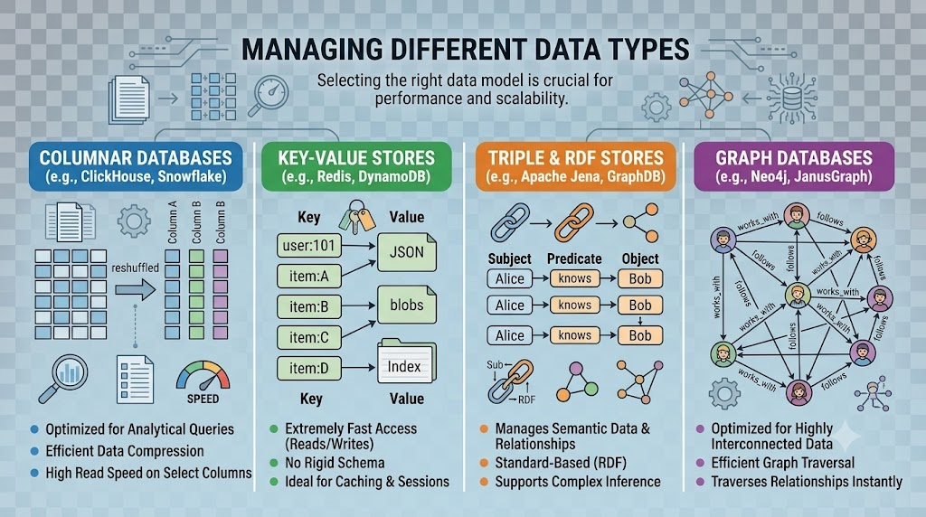

Slide 48
Managing Diverse Data Types in NoSQL
Modern applications generate data in many shapes: tabular, key-based, semantic, and highly interconnected, and no single structure suits them all.
NoSQL databases specialize by data type, allowing each system to optimize storage, indexing, and querying for a particular pattern.
Selecting the right data management approach depends on factors such as query complexity, write frequency, and relationship density.
Understanding the internal structure of each NoSQL type helps architects predict performance characteristics before deployment.
This lecture examines four major approaches: columnar stores, key-value stores, triple stores, and graph stores.

Slide 49
Columnar (Column-Family) Databases
Columnar databases store data by columns grouped into column families rather than storing complete rows together, as in relational systems.
This structure allows efficient compression and fast reads when queries only need a subset of columns across many rows.
Column-family systems like Apache Cassandra and HBase are optimized for write-heavy workloads and massive horizontal scalability.
Data is often organized using a row key, column family, and column qualifier, enabling flexible and sparse data storage.
Columnar stores excel in time-series data, analytics, and applications requiring high write throughput across distributed clusters.

Slide 50
Key-Value Stores
Key-value stores manage data as a simple collection of unique keys mapped directly to opaque values, without imposing internal structure on the value.
This simplicity allows extremely fast reads and writes, often achieving sub-millisecond latency for lookups by key.
Popular key-value stores include Redis, Amazon DynamoDB, and Riak, each tuned for caching, session storage, or distributed configuration data.
Because values are opaque to the database engine, complex queries on value content are typically not supported without additional indexing.
Key-value stores are ideal for use cases like caching, shopping carts, and real-time leaderboard tracking where lookup speed is paramount.

Slide 51
Triple Stores
Triple stores manage data as subject-predicate-object statements, following the Resource Description Framework (RDF) model used in semantic web applications.
Each triple represents a single fact, such as 'Person-worksAt-Company', enabling rich representation of knowledge and metadata.
Triple stores support SPARQL, a query language designed specifically for traversing and querying RDF graphs of interconnected facts.
Examples include Apache Jena, AllegroGraph, and Amazon Neptune, which support both triple and property graph models.
Triple stores are widely used in knowledge graphs, ontology management, and applications requiring formal semantic reasoning.

Slide 52
Real-World Example: Columnar Stores at Spotify
Spotify uses Apache Cassandra to manage massive volumes of user listening history and playlist data across a globally distributed user base.
The column-family model allows Spotify to efficiently store sparse, time-stamped listening events without rigid schema constraints.
High write throughput supports millions of concurrent streaming sessions generating continuous playback events.
Cassandra's linear scalability lets Spotify add capacity smoothly as its user base and catalog continue to grow.
This case illustrates how columnar databases handle high-velocity, write-intensive data at global scale.

Slide 53
Real-World Example: Graph Stores at LinkedIn's Economic Graph
LinkedIn built its Economic Graph using graph database principles to model relationships among members, companies, skills, and jobs.
Graph traversal algorithms power features like 'People You May Know' by efficiently finding connections within a few relationship hops.
Traditional relational JOINs would become prohibitively slow at LinkedIn's scale of hundreds of millions of interconnected nodes.
Graph databases represent entities as nodes and relationships as edges, making multi-hop queries dramatically faster than relational alternatives.
This example shows how graph stores uniquely solve problems involving deep, complex relationship networks that other NoSQL types cannot efficiently handle.

Slide 54
Advanced Topics: Choosing and Combining Data Stores
Property graph databases, such as Neo4j, extend the triple model by allowing rich attributes on both nodes and relationships, not just simple facts.
Hybrid and multi-model databases increasingly combine graph, document, and key-value capabilities within a single engine to reduce architectural complexity.
Benchmarking traversal depth, write throughput, and query latency helps determine whether a graph, columnar, or key-value approach best fits a workload.
Emerging research investigates GPU-accelerated graph processing and distributed triple store reasoning for large-scale knowledge graphs.
Organizations often combine multiple data store types in a single architecture, using each for the data pattern it manages most efficiently.

Slide 55
Summary
Different NoSQL data types are optimized for distinct data patterns: columnar for wide, sparse datasets, key-value for fast lookups, triple stores for semantic facts, and graph stores for relationships.
Columnar databases like Cassandra excel at high-throughput, write-heavy workloads distributed across many nodes.
Key-value stores prioritize raw speed and simplicity, making them ideal for caching and session management.
Triple stores use the subject-predicate-object model to represent and query interconnected knowledge using standards like RDF and SPARQL.
Graph stores efficiently traverse deeply connected data, outperforming relational JOINs for relationship-heavy queries.
Real-world systems, from Spotify to LinkedIn, demonstrate how choosing the right data store type directly impacts performance and scalability.

Slide 56
Discussion Questions
Why would a columnar database be a poor choice for an application that primarily requires complex, multi-hop relationship queries?
In what scenarios would a triple store's semantic reasoning capabilities provide advantages over a standard property graph database?
How might an organization decide whether to combine a key-value store with a graph database rather than using a single unified system?

Slide 57
References
Sadalage, P. J., & Fowler, M. (2013). NoSQL Distilled: A Brief Guide to the Emerging World of Polyglot Persistence. Addison-Wesley.
Robinson, I., Webber, J., & Eifrem, E. (2015). Graph Databases: New Opportunities for Connected Data (2nd ed.). O'Reilly Media.
Lassila, O., & Swick, R. R. (1999). Resource Description Framework (RDF) Model and Syntax Specification. W3C Recommendation.
Lakshman, A., & Malik, P. (2010). Cassandra: A Decentralized Structured Storage System. ACM SIGOPS Operating Systems Review, 44(2), 35-40.
Neo4j, Inc. (2024). Graph Databases for Beginners. https://neo4j.com/developer/graph-database/

Slide 58
THANK YOU
We hope this lecture was insightful and engaging.

Slide 59
Document Databases and Search Engines
NoSQL Database
CS3EL17
Dr. Latika Jindal

Slide 60
Learning Objectives
Understand the structure and design principles of document-oriented NoSQL databases.
Explain how document databases represent, store, and query semi-structured data.
Describe the role of search engines as a specialized category of NoSQL data management systems.
Analyze how inverted indexes enable fast full-text search across large document collections.
Compare document databases and search engines in terms of query capability and intended use cases.
Evaluate real-world applications that combine document storage with search engine technology.

Slide 61
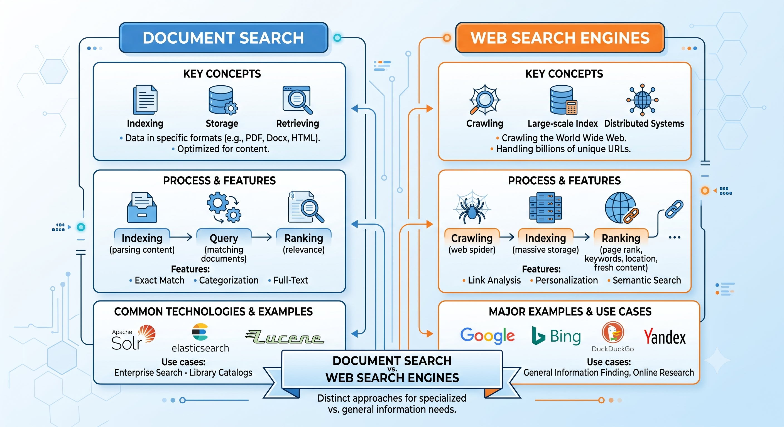

Slide 62
Introduction to Document Databases
Document databases store data as self-contained documents, typically in JSON, BSON, or XML format, rather than in fixed rows and columns.
Each document can have a different structure, allowing fields to be added, removed, or nested without altering a rigid schema.
Documents are usually grouped into collections, which loosely resemble tables but do not enforce uniform structure across records.
Popular document databases include MongoDB, Couchbase, and Amazon DocumentDB, widely used for content management and catalog systems.
This flexibility makes document databases well suited to applications with evolving or hierarchical data, such as user profiles or product catalogs.

Slide 63
Document Database Architecture and Querying
Documents are typically identified by a unique key and can be retrieved directly or queried using fields within the document body.
Most document databases support secondary indexes on nested fields, enabling efficient queries beyond simple key lookups.
Embedding related data within a single document reduces the need for JOIN-like operations common in relational databases.
Sharding distributes documents across multiple servers based on a shard key, supporting horizontal scalability for large collections.
Aggregation frameworks, such as MongoDB's pipeline, allow complex data transformations and analytics directly within the database.

Slide 64
Search Engines as NoSQL Systems
Search engines, such as Elasticsearch and Apache Solr, are specialized NoSQL systems optimized for full-text search rather than transactional storage.
These systems index unstructured and semi-structured text, enabling fast retrieval based on relevance rather than exact matches alone.
Search engines are built on an inverted index structure, mapping terms to the documents in which they appear.
Ranking algorithms, such as TF-IDF and BM25, score documents by relevance to a query, going beyond simple boolean matching.
Search engines often integrate with document databases, indexing content stored elsewhere to provide fast, relevance-ranked search capabilities.

Slide 65
Inverted Indexes and Search Mechanics
An inverted index maps each unique term in a document collection to a list of documents containing that term, dramatically speeding up text search.
Tokenization breaks text into individual terms, while stemming and lemmatization normalize word variants to improve match accuracy.
Stop-word removal filters out common words, such as 'the' or 'and', that carry little value for search relevance.
Faceted search allows users to filter results by categories or attributes, commonly seen in e-commerce product search.
Near real-time indexing allows newly added or updated documents to become searchable within seconds, critical for dynamic content platforms.

Slide 66
Real-World Example: Document Databases at Forbes
Forbes migrated its content management system to MongoDB to handle diverse and evolving article formats, including embedded media and metadata.
The flexible document model allowed editorial teams to add new content types without requiring database schema migrations.
Horizontal scaling supported traffic spikes during major news events without degrading site performance.
Nested document structures let Forbes store article versions, author metadata, and related content within a single retrievable unit.
This case demonstrates how document databases support fast-changing content platforms with unpredictable structural requirements.

Slide 67
Real-World Example: Search Engines at Wikipedia and GitHub
Wikipedia uses Elasticsearch to power its full-text search, allowing users to find relevant articles even with imprecise or partial search terms.
GitHub relies on Elasticsearch to index billions of lines of code and repository metadata, enabling fast code search across the platform.
Both platforms depend on inverted indexes and relevance ranking to return useful results from massive, constantly growing text collections.
Near real-time indexing ensures newly pushed code or edited articles become searchable almost immediately after being published.
These examples highlight how search engine technology complements document storage by adding fast, relevance-driven retrieval at scale.

Slide 68
Advanced Topics: Combining Document Storage and Search
Many modern architectures use a document database as the system of record while a search engine like Elasticsearch serves as a specialized search layer.
Change data capture pipelines synchronize updates from a document database into a search index, keeping search results current.
Vector search and semantic search extend traditional inverted indexes to support similarity-based retrieval using machine learning embeddings.
Scaling search engines across distributed clusters introduces challenges in index sharding, replication, and query latency management.
Ongoing research explores combining full-text search with graph and vector techniques to power more context-aware search experiences.

Slide 69
Summary
Document databases store flexible, self-describing records, making them ideal for applications with evolving or hierarchical data structures.
Search engines are a specialized NoSQL category optimized for full-text search using inverted indexes and relevance ranking.
Inverted indexes, tokenization, and ranking algorithms like BM25 enable search engines to retrieve results based on relevance rather than exact matches.
Real-world platforms like Forbes rely on document databases for flexible content storage, while Wikipedia and GitHub rely on search engines for fast retrieval.
Document databases and search engines are often combined, with the document store as the system of record and the search engine as a query layer.
Emerging techniques like vector and semantic search are extending traditional search engine capabilities beyond simple keyword matching.

Slide 70
Discussion Questions
What characteristics of an application's data would make a document database more suitable than a relational database?
How does an inverted index enable a search engine to return relevant results faster than scanning documents directly for keyword matches?
What challenges might arise when synchronizing data between a document database and a separate search engine index in real time?

Slide 71
References
Sadalage, P. J., & Fowler, M. (2013). NoSQL Distilled: A Brief Guide to the Emerging World of Polyglot Persistence. Addison-Wesley.
Chodorow, K. (2013). MongoDB: The Definitive Guide (2nd ed.). O'Reilly Media.
Gormley, C., & Tong, Z. (2015). Elasticsearch: The Definitive Guide. O'Reilly Media.
Manning, C. D., Raghavan, P., & Schutze, H. (2008). Introduction to Information Retrieval. Cambridge University Press.
Elastic NV. (2024). Elasticsearch Reference Documentation. https://www.elastic.co/guide/en/elasticsearch/reference/current/index.html

Slide 72
THANK YOU
We hope this lecture was insightful and engaging.

Slide 73
Hybrid NoSQL Databases and Applying Consistency Methods
NoSQL Database
CS3EL17
Dr. Latika Jindal

Slide 74
Learning Objectives
Understand the concept of hybrid, or multi-model, NoSQL databases and their motivation.
Identify how hybrid databases combine document, graph, key-value, and columnar capabilities within a single engine.
Explain the major consistency models used across NoSQL systems, including strong, eventual, and tunable consistency.
Analyze techniques such as quorum reads and writes, vector clocks, and conflict resolution for maintaining consistency.
Evaluate the trade-offs organizations face when applying different consistency methods to real-world applications.
Apply appropriate consistency strategies based on specific business and technical requirements.

Slide 75
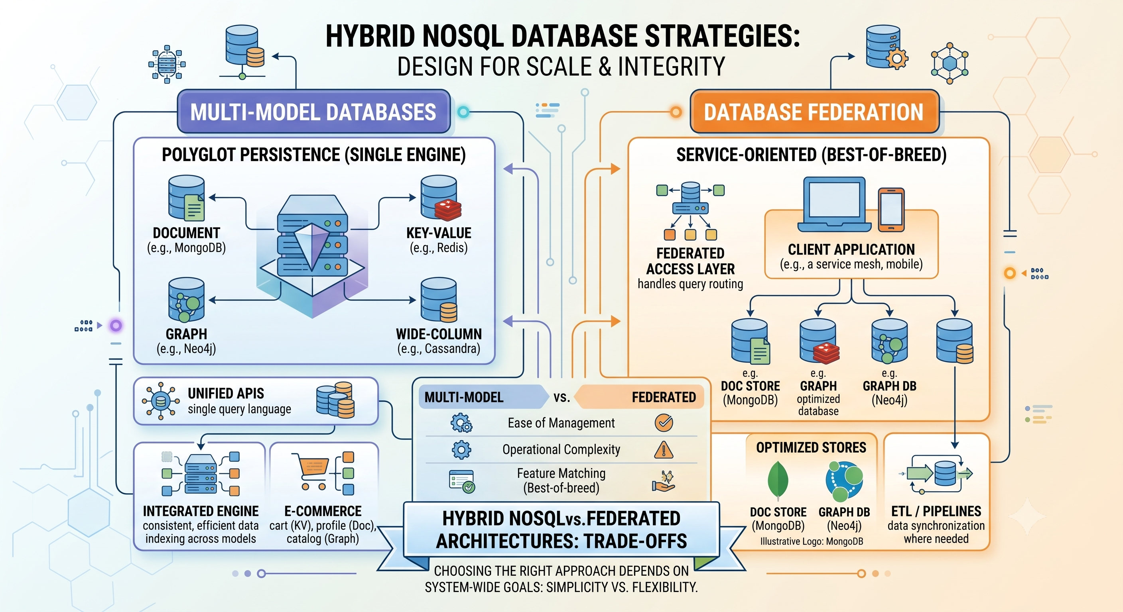

Slide 76
What Are Hybrid NoSQL Databases?
Hybrid, or multi-model, databases combine two or more data models, such as document, graph, key-value, or columnar, within a single database engine.
This approach reduces architectural complexity by eliminating the need to operate and synchronize separate specialized databases.
Examples include ArangoDB, which supports document, graph, and key-value models, and Microsoft's Azure Cosmos DB, which supports multiple APIs over one engine.
Hybrid databases emerged as organizations found that real-world applications often need more than one data model simultaneously.
This trend reflects a shift from choosing a single NoSQL category toward building unified platforms that adapt to varied application needs.

Slide 77
Architecture of Multi-Model Systems
Multi-model databases typically store data in a common internal format while exposing multiple query interfaces tailored to each data model.
A single record might be queried as a document, traversed as part of a graph, or retrieved directly as a key-value pair, depending on the use case.
This unified storage layer avoids the data duplication and synchronization overhead required when using separate specialized databases together.
Multi-model systems must carefully balance performance across data models, since optimizing for one model can sometimes degrade another.
Vendors increasingly market hybrid databases as reducing operational overhead, since a single system handles diverse workloads that once required several tools.

Slide 78
Consistency Models in NoSQL
Strong consistency guarantees that any read immediately reflects the most recent write, matching traditional relational database behavior.
Eventual consistency allows temporary divergence between replicas, guaranteeing they will converge to the same value given enough time without new updates.
Tunable consistency, offered by systems like Cassandra, allows developers to choose consistency levels per operation, balancing speed against accuracy.
Causal consistency ensures that operations which are causally related are seen by all nodes in the same order, even if unrelated operations may not be.
Choosing a consistency model involves trading off latency, availability, and correctness based on the specific needs of an application.

Slide 79
Techniques for Applying Consistency
Quorum-based reads and writes require a minimum number of replicas to acknowledge an operation, balancing consistency and availability.
Vector clocks track the causal history of updates across distributed replicas, helping systems detect and resolve conflicting writes.
Conflict-free replicated data types (CRDTs) allow concurrent updates across replicas to merge automatically without conflicts.
Read-repair mechanisms detect and correct stale replicas during normal read operations, gradually improving consistency over time.
Hinted handoff temporarily stores writes intended for an unavailable node, replaying them once the node returns, to reduce data loss during outages.

Slide 80
Real-World Example: Hybrid Databases at eBay
eBay adopted a multi-model approach, combining document storage for product listings with graph capabilities for recommendation relationships.
This hybrid strategy reduced the need to maintain separate synchronized systems for catalog data and relationship-based recommendations.
Engineers reported simplified application logic since a single query layer could handle both document retrieval and relationship traversal.
The unified system improved consistency between product data and related recommendation graphs, since both lived in the same underlying store.
This case illustrates how hybrid NoSQL databases can consolidate previously fragmented data architectures into a more maintainable system.

Slide 81
Real-World Example: Applying Consistency at Amazon Shopping Cart
Amazon's original DynamoDB paper describes how the shopping cart service applied eventual consistency to maximize availability during high traffic events.
Vector clocks were used to track concurrent updates to a customer's cart from multiple devices or sessions.
When conflicting cart versions were detected, the system merged them by taking the union of items rather than discarding either version.
This approach prioritized never losing a customer's cart item over guaranteeing an instantly consistent view across all replicas.
This example shows how a specific business priority, avoiding lost sales, directly shaped the choice and implementation of a consistency method.

Slide 82
Advanced Topics: The Future of Hybrid and Consistency Strategies
Distributed SQL and NewSQL systems increasingly blend strong consistency guarantees with the horizontal scalability associated with NoSQL and hybrid databases.
Research into hybrid logical clocks aims to combine the simplicity of physical time with the correctness guarantees of logical vector clocks.
Multi-model databases face ongoing challenges in query optimization, since a single query planner must reason across fundamentally different data models.
Edge computing introduces new consistency challenges, as data must often be synchronized across devices with intermittent connectivity.
As applications grow more complex, organizations increasingly evaluate hybrid databases and tunable consistency together to balance flexibility, performance, and correctness.

Slide 83
Summary
Hybrid, or multi-model, NoSQL databases combine multiple data models within a single engine, reducing architectural complexity.
Systems like ArangoDB and Azure Cosmos DB allow the same data to be queried as documents, graphs, or key-value pairs.
NoSQL consistency models range from strong consistency to eventual and tunable consistency, each offering different trade-offs.
Techniques such as quorum reads and writes, vector clocks, and CRDTs help systems apply consistency methods in distributed environments.
Real-world cases like eBay's hybrid architecture and Amazon's shopping cart demonstrate how these concepts solve concrete business problems.
Choosing the right hybrid architecture and consistency strategy requires balancing latency, availability, and correctness for the application at hand.

Slide 84
Discussion Questions
What advantages might a hybrid, multi-model database offer over maintaining separate specialized databases for an application with diverse data needs?
How do vector clocks help distributed systems detect and resolve conflicting writes without relying on a single centralized clock?
In what type of application would tunable consistency be more valuable than strictly enforcing either strong or eventual consistency at all times?

Slide 85
References
Sadalage, P. J., & Fowler, M. (2013). NoSQL Distilled: A Brief Guide to the Emerging World of Polyglot Persistence. Addison-Wesley.
DeCandia, G., Hastorun, D., Jampani, M., et al. (2007). Dynamo: Amazon's Highly Available Key-value Store. Proceedings of the 21st ACM SIGOPS Symposium on Operating Systems Principles.
Shapiro, M., Preguica, N., Baquero, C., & Zawirski, M. (2011). Conflict-Free Replicated Data Types. Stabilization, Safety, and Security of Distributed Systems, 386-400.
Vogels, W. (2009). Eventually Consistent. Communications of the ACM, 52(1), 40-44.
ArangoDB GmbH. (2024). Multi-Model Database Documentation. https://www.arangodb.com/docs/

Slide 86
THANK YOU
We hope this lecture was insightful and engaging.

Slide 87
ACID, BASE, and Polyglot Persistence
NoSQL Database
CS3EL17
Dr. Latika Jindal

Slide 88
Learning Objectives
Understand the four properties of ACID transactions: Atomicity, Consistency, Isolation, and Durability.
Explain the BASE model and how it contrasts with the traditional ACID approach to data management.
Analyze why NoSQL systems often favor BASE properties over strict ACID guarantees.
Define polyglot persistence and describe why organizations adopt multiple database technologies together.
Evaluate the trade-offs between ACID and BASE models for different categories of applications.
Apply polyglot persistence principles to design a data architecture suited to varied application requirements.

Slide 89
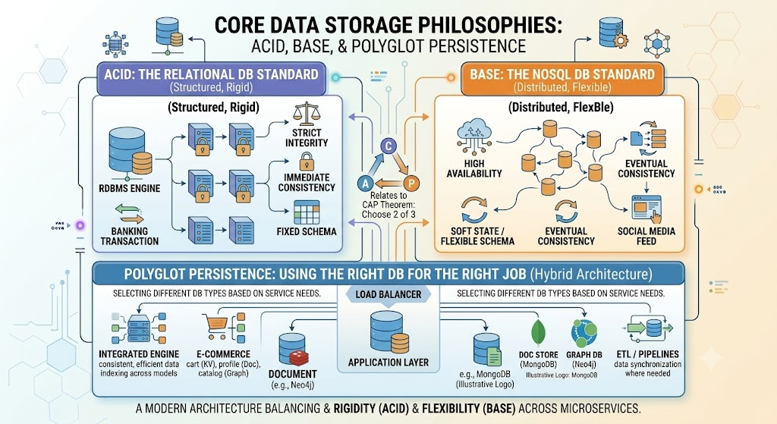

Slide 90
Understanding ACID Properties
Atomicity ensures that a transaction is treated as a single indivisible unit, either completing entirely or not applying any changes at all.
Consistency guarantees that a transaction moves the database from one valid state to another, preserving all defined rules and constraints.
Isolation ensures that concurrently executing transactions do not interfere with each other, as if they were executed sequentially.
Durability guarantees that once a transaction is committed, its changes persist even in the event of a system failure or crash.
ACID transactions are foundational to relational databases and remain essential for applications like banking and financial record-keeping.

Slide 91
Introducing the BASE Model
BASE stands for Basically Available, Soft state, and Eventually consistent, describing an alternative philosophy to strict ACID compliance.
Basically Available means the system guarantees availability of data, even if some parts of the system fail, prioritizing responsiveness.
Soft state indicates that the state of the system may change over time, even without new input, due to eventual consistency processes.
Eventually consistent means that, given enough time without new updates, all replicas of the data will converge to the same value.
BASE emerged as distributed systems needed to prioritize availability and partition tolerance over the strict consistency guaranteed by ACID.

Slide 92
ACID vs BASE: A Direct Comparison
ACID prioritizes correctness and strict consistency, while BASE prioritizes availability and responsiveness under distributed conditions.
ACID transactions are typically implemented with locking mechanisms that can reduce throughput in highly concurrent, distributed environments.
BASE systems allow temporary inconsistency between replicas, which is acceptable for applications where slightly stale data does not cause harm.
Relational databases like PostgreSQL and MySQL are built around ACID, while many NoSQL databases like Cassandra and DynamoDB embrace BASE principles.
Choosing between ACID and BASE depends on whether an application can tolerate temporary inconsistency in exchange for greater scalability and availability.

Slide 93
What is Polyglot Persistence?
Polyglot persistence refers to using multiple, different database technologies within a single application architecture, each chosen for a specific purpose.
Rather than forcing all data into one database type, polyglot persistence matches each data category to the storage technology best suited for it.
For example, an application might use a relational database for financial transactions, a document database for content, and a graph database for relationships.
This approach recognizes that no single database technology excels at every type of data access pattern and workload.
Polyglot persistence increases architectural flexibility but also introduces additional operational complexity in managing multiple systems.

Slide 94
Real-World Example: ACID and BASE Together at Uber
Uber uses ACID-compliant relational databases for critical financial transactions, such as calculating and processing driver payments.
For high-velocity data like real-time location tracking, Uber relies on NoSQL systems that embrace BASE principles for greater availability.
This dual approach reflects a deliberate architectural decision: strict correctness where money is involved, and flexibility where speed matters most.
Uber's engineering teams evaluate each service individually to determine whether ACID or BASE properties better serve its specific requirements.
This example shows that ACID and BASE are not mutually exclusive choices but complementary strategies applied selectively across a system.

Slide 95
Real-World Example: Polyglot Persistence at Netflix
Netflix employs a polyglot persistence strategy, using Cassandra for viewing history, MySQL for billing, and Elasticsearch for search functionality.
Each database technology was selected based on its strengths: Cassandra for write-heavy scalability, MySQL for transactional billing accuracy, and Elasticsearch for fast text search.
This architecture allows Netflix's engineering teams to optimize each service independently rather than compromising on a single, one-size-fits-all database.
Managing multiple database technologies requires specialized expertise and increases the operational overhead of monitoring and maintaining each system.
Netflix's approach exemplifies how large-scale organizations apply polyglot persistence to balance performance, consistency, and scalability across diverse workloads.

Slide 96
Advanced Topics: Designing for ACID, BASE, and Polyglot Architectures
NewSQL databases, such as Google Spanner and CockroachDB, attempt to provide ACID guarantees while still achieving horizontal, distributed scalability.
Saga patterns coordinate distributed transactions across multiple polyglot services without relying on a single global ACID transaction.
Data synchronization and change data capture pipelines become critical challenges when maintaining consistency across a polyglot persistence architecture.
Choosing between ACID, BASE, or a hybrid approach increasingly depends on service-level requirements defined at the microservice level, not the whole application.
Ongoing research explores automated tools to help architects decide which consistency model and database technology best fit each component of a distributed system.

Slide 97
Summary
ACID properties, Atomicity, Consistency, Isolation, and Durability, provide strong transactional guarantees traditionally associated with relational databases.
The BASE model, Basically Available, Soft state, Eventually consistent, prioritizes availability and scalability over strict consistency.
NoSQL systems generally favor BASE principles to support the demands of large-scale, distributed, highly available applications.
Polyglot persistence involves using multiple specialized database technologies together, each matched to a specific data pattern within an application.
Real-world companies like Uber and Netflix apply ACID, BASE, and polyglot persistence strategically, based on the specific needs of each service.
Effective system design requires evaluating consistency, availability, and data variety requirements at the service level rather than applying one model universally.

Slide 98
Discussion Questions
Why might a company choose to apply ACID guarantees to one part of its system while applying BASE principles to another part of the same application?
What operational challenges might arise from adopting a polyglot persistence strategy involving three or more distinct database technologies?
How do NewSQL systems attempt to combine the benefits of ACID transactions with the horizontal scalability typically associated with BASE-oriented NoSQL systems?

Slide 99
References
Sadalage, P. J., & Fowler, M. (2013). NoSQL Distilled: A Brief Guide to the Emerging World of Polyglot Persistence. Addison-Wesley.
Pritchett, D. (2008). BASE: An ACID Alternative. ACM Queue, 6(3), 48-55.
Haerder, T., & Reuter, A. (1983). Principles of Transaction-Oriented Database Recovery. ACM Computing Surveys, 15(4), 287-317.
Corbett, J. C., Dean, J., Epstein, M., et al. (2013). Spanner: Google's Globally Distributed Database. ACM Transactions on Computer Systems, 31(3), 1-22.
Fowler, M. (2011). Polyglot Persistence. https://martinfowler.com/bliki/PolyglotPersistence.html

Slide 100
THANK YOU
We hope this lecture was insightful and engaging.

